Slide 1

AI-POWERED CONSTRUCTION SITE MONITORING AND SAFETY MANAGEMENT SYSTEM
FELIX KEVINSINGH T: 312321202016
JAMES ROBIN RAJ P : 312321202022
TEAM GUIDE: Dr ANCY S

Slide 2
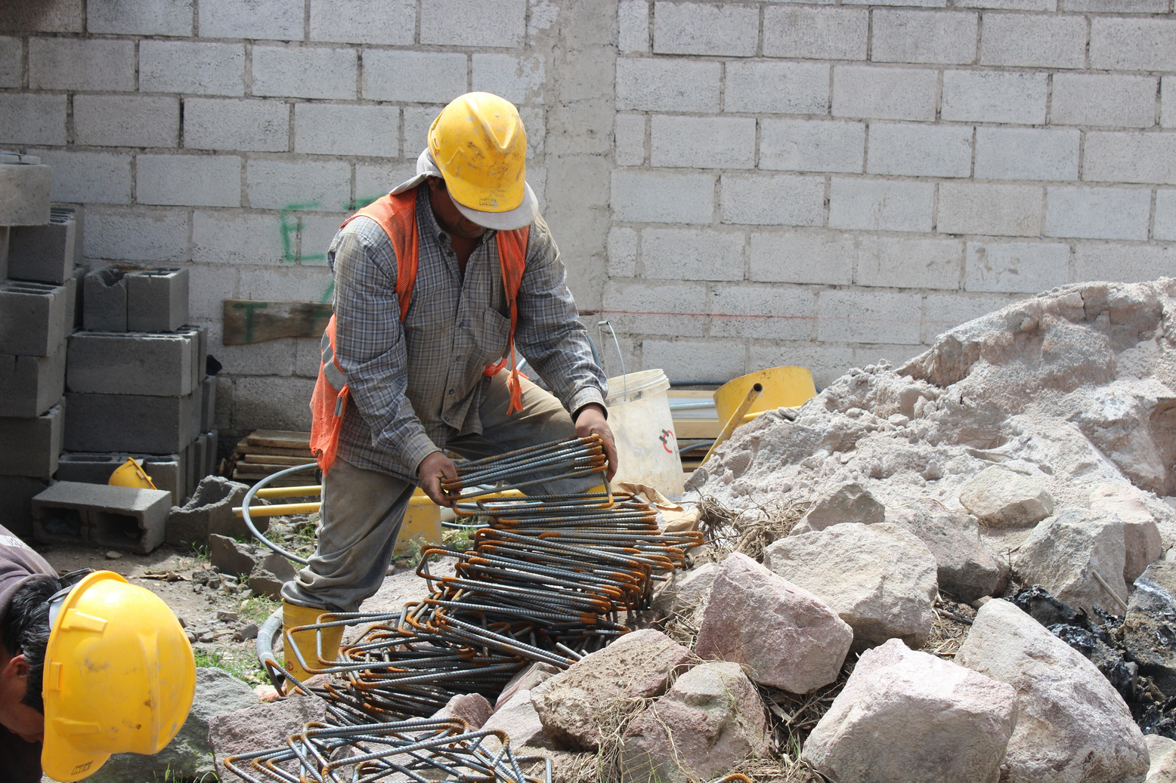
ABSTRACT
Computer vision enables real-time construction site monitoring by analyzing visual data to track progress, detect anomalies, and ensure safety compliance, thereby improving overall site management. Enhanced by deep learning, the system achieves high detection accuracy for construction activities, safety hazards, and unauthorized access, facilitating proactive safety enforcement and optimized workflow management. Additionally, it automates milestone tracking, monitors material and machinery usage, and ensures efficient resource allocation, ultimately reducing waste and enhancing decision-making across construction projects.

Slide 3
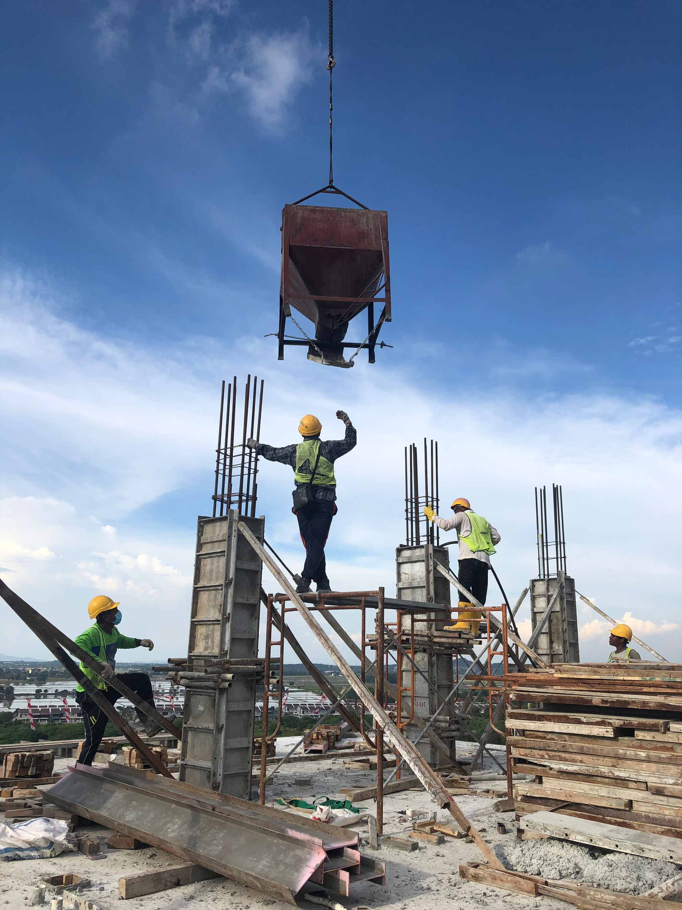
OBJECTIVE OF OUR PROJECT
Real-time Monitoring:
Implement real-time video surveillance and monitoring of construction sites using computer vision to track progress and detect anomalies.
Safety Compliance:
Detect potential safety hazards such as the absence of personal protective equipment (PPE), unsafe behaviors, and unauthorized personnel on the site.
Resource Utilization:
Monitor the efficient use of materials and machinery on-site to prevent wastage and optimize resource allocation.

Slide 4
EXISTING SYSTEM
AI-based Video Surveillance and Object Detection:
Utilizes YOLOv3 and YOLOX models for real-time monitoring of construction sites.
Detects workers, machinery, and unauthorized personnel to enhance site security and safety compliance.
Deep Learning for Structural Inspection and Crack Detection:
Uses CNN-based models like VGG and ResNet to identify cracks and structural weaknesses in buildings.
Helps in early detection of potential hazards, reducing risks associated with construction failures.
NLP-powered Safety and Monitoring Dashboard:
Implements RNNs and Transformer-based models to provide real-time updates on project status, worker safety, and equipment usage.
Allows managers to interact using text and voice commands, improving communication efficiency.

Slide 5
DRAWBACKS OF EXISTING SYSTEM
AI-based Video Surveillance and Object Detection:
Struggles with detecting small objects and minor safety violations.
Requires high computational resources for real-time processing.
Prone to false positives, leading to unnecessary alerts.
Deep Learning for Structural Inspection and Crack Detection:
Dependent on high-quality image datasets for accurate detection.
Environmental factors like lighting and shadows affect accuracy.
Computationally expensive and requires specialized hardware.
NLP-powered Safety and Monitoring Dashboard:
Needs extensive training data to understand construction-specific terminology.
May misinterpret complex queries, leading to inaccurate responses.
High dependency on internet connectivity for cloud-based processing.

Slide 6
PROPOSED WORK
AI-powered Worker Monitoring and Unauthorized Access Detection:
Uses CCTV-based AI to track worker movements and detect unsafe behaviors.
Implements facial recognition for attendance and sends automated alerts if PPE is missing.
Material Detection and Hazard Identification:
AI-driven drones classify and count materials like sand, cement, and steel for inventory management.
Identifies hazards such as slippery surfaces and restricted zones, triggering real-time alerts.
NLP-Powered Smart Dashboard for Monitoring:
Provides an interactive interface for real-time site updates using voice or text queries.
Enhances decision-making by analyzing worker behavior, material usage, and safety compliance.

Slide 7
LITERATURE SURVEY
SNO | AUTHOR,TITLE & YEAR | METHODOLOGY | ADVANTAGES | DISADVANTAGES
1 | Redmon, J., & Farhadi, A. - YOLOv3: An Incremental Improvement (2018) | Introduces YOLOv3, a real-time object detection algorithm using deep convolutional neural networks. | High-speed object detection, effective in real-time applications like surveillance and material tracking. | Less accurate for small object detection compared to region-based methods.
2 | Simonyan, K., & Zisserman, A. - Very Deep Convolutional Networks for Large-Scale Image Recognition (2014) | Proposes deep convolutional neural networks (VGG) for image classification and recognition. | High accuracy in image-based tasks, useful for crack detection and structural analysis. | Computationally expensive, requiring significant processing power.
3 | Goodfellow, I., Bengio, Y., & Courville, A. - Deep Learning (2016) | Provides foundational concepts and principles of deep learning models. | Comprehensive coverage of deep learning techniques, aiding model selection and design. | Theoretical focus, requiring additional practical insights for implementation.
4 | Schmidhuber, J. - Deep Learning in Neural Networks: An Overview (2015) | Reviews deep learning architectures and their applications. | Helps in selecting the right models for real-time construction monitoring. | Lacks hands-on implementation details.

Slide 8
SNO | AUTHOR,TITLE & YEAR | METHODOLOGY | ADVANTAGES | DISADVANTAGES
5 | Mnih, V., Heess, N., Graves, A., & Kavukcuoglu, K. - Recurrent Models of Visual Attention (2014) | Introduces attention mechanisms in deep learning models. | Improves focus in safety management and gesture recognition modules. | Computationally demanding, may require hardware optimization.
6 | He, K., Zhang, X., Ren, S., & Sun, J. - Deep Residual Learning for Image Recognition (2016) | Proposes ResNet for deep neural networks, improving image classification tasks. | Effective for crack detection and material recognition with high accuracy. | Increased model complexity and training time.
7 | Cho, K., Merrienboer, B., Gulcehre, C., et al. - Learning Phrase Representations using RNN Encoder-Decoder for Statistical Machine Translation (2014) | Uses RNNs for sequence-to-sequence learning in NLP. | Enables the NLP-powered dashboard for query handling. | Struggles with long-range dependencies and requires large datasets.
8 | Chollet, F. - Xception: Deep Learning with Depthwise Separable Convolutions (2017) | Introduces Xception networks for efficient image processing. | Reduces computational cost while maintaining accuracy in surveillance tasks. | Requires significant training data for best performance.

Slide 9
SNO | AUTHOR,TITLE & YEAR | METHODOLOGY | ADVANTAGES | DISADVANTAGES
9 | Szeliski, R. - Computer Vision: Algorithms and Applications (2010) | Provides an in-depth understanding of computer vision techniques. | Useful for worker tracking, crack detection, and material classification. | Some methods are outdated due to advancements in deep learning.
10 | Ge, Z., Liu, S., Wang, F., Li, Z., & Sun, J. - YOLOX: Exceeding YOLO Series in 2021 (2021) | Enhances YOLO object detection models for better performance. | Improves accuracy and speed in real-time monitoring. | Requires optimized implementation for real-time applications.

Slide 10




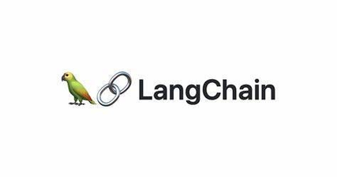





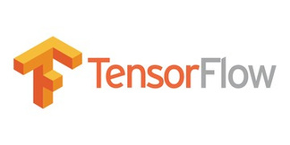


DEPENDENCIES
Front-End
Framework
Framework
Libraries

Slide 11
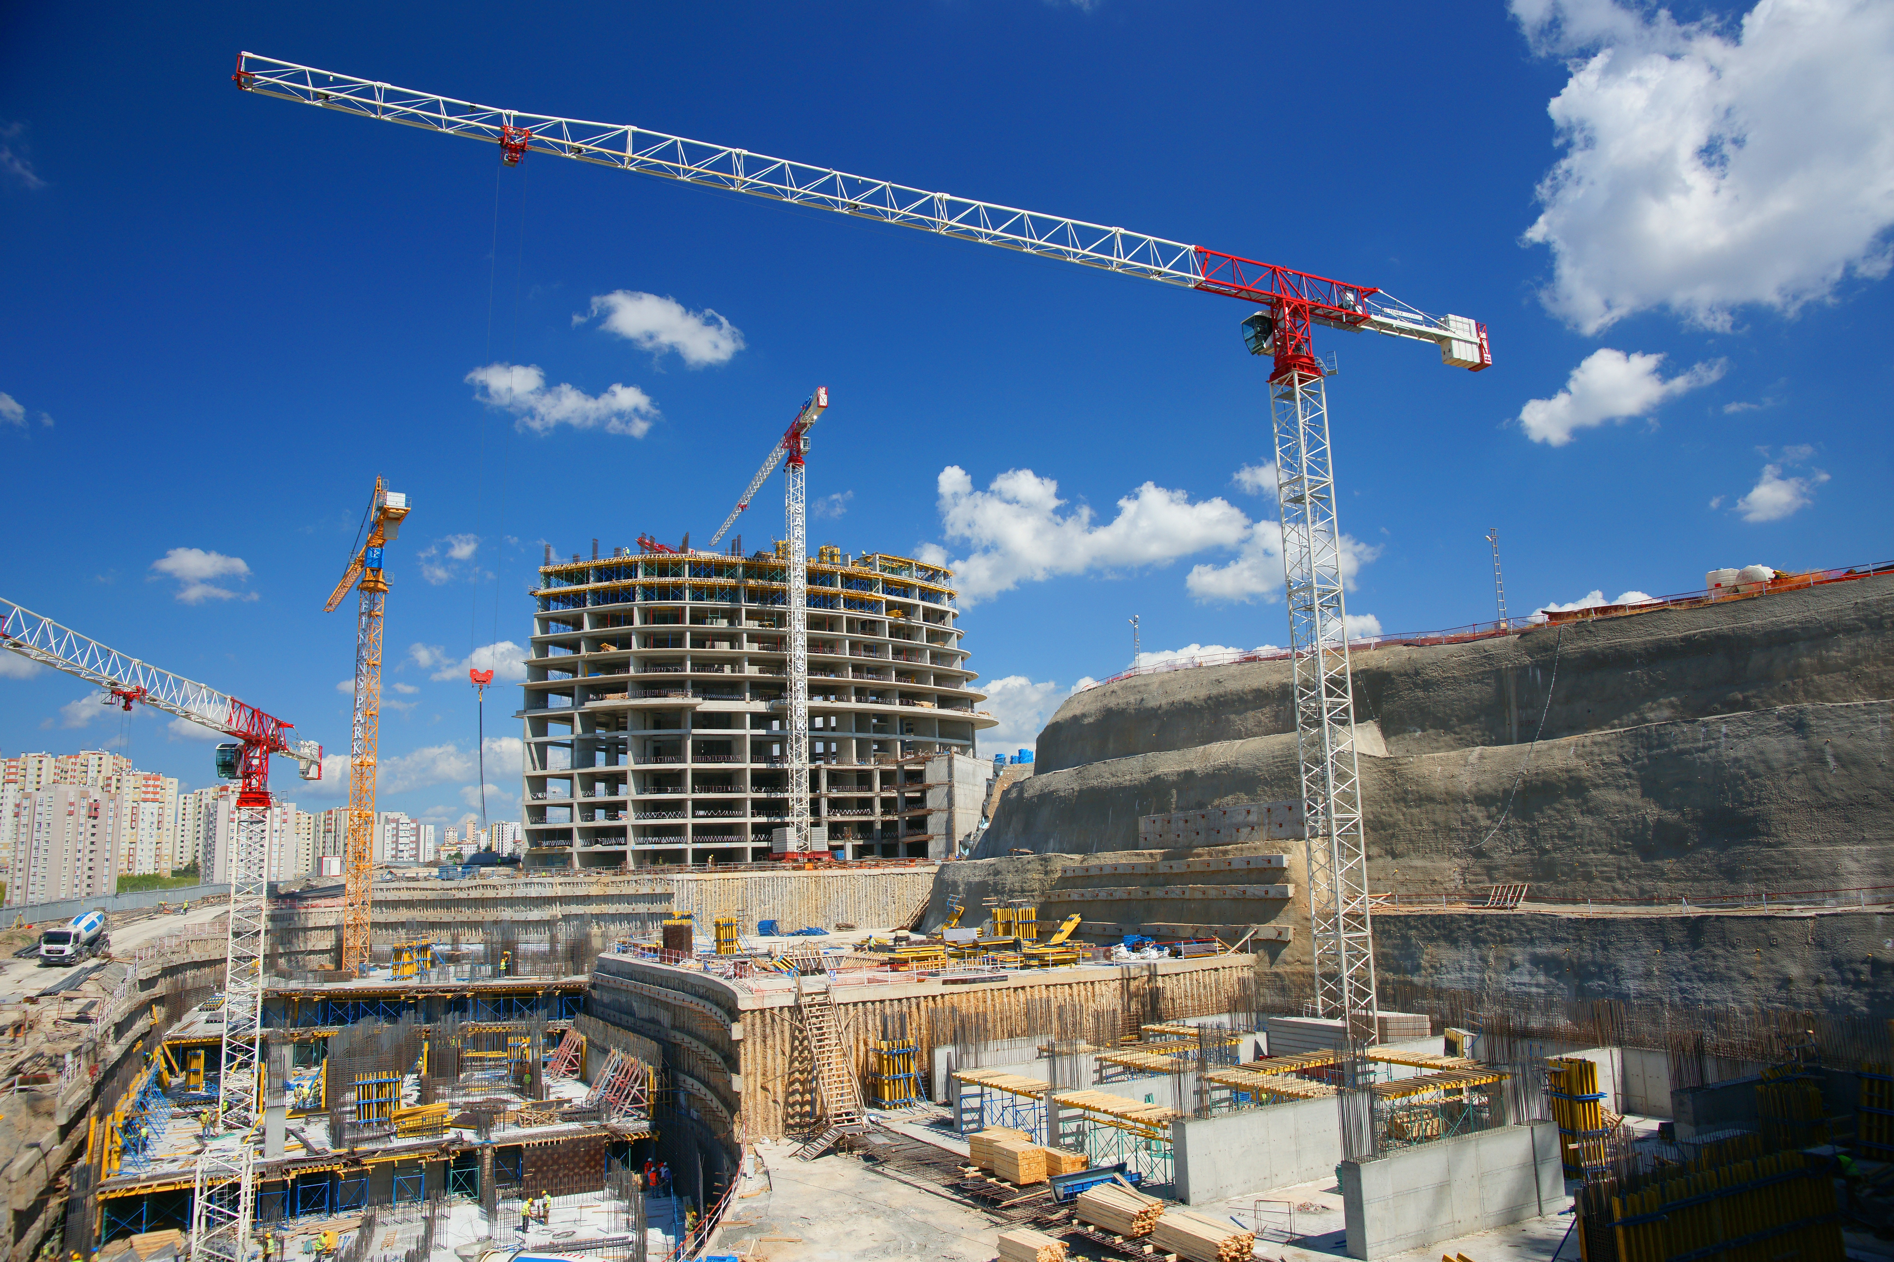
Enhanced Safety and Compliance
ADVANTAGES OF PROPOSED WORK
Smart and Efficient Monitoring
Time-Saving Monitoring
Interactive Site Insights

Slide 12
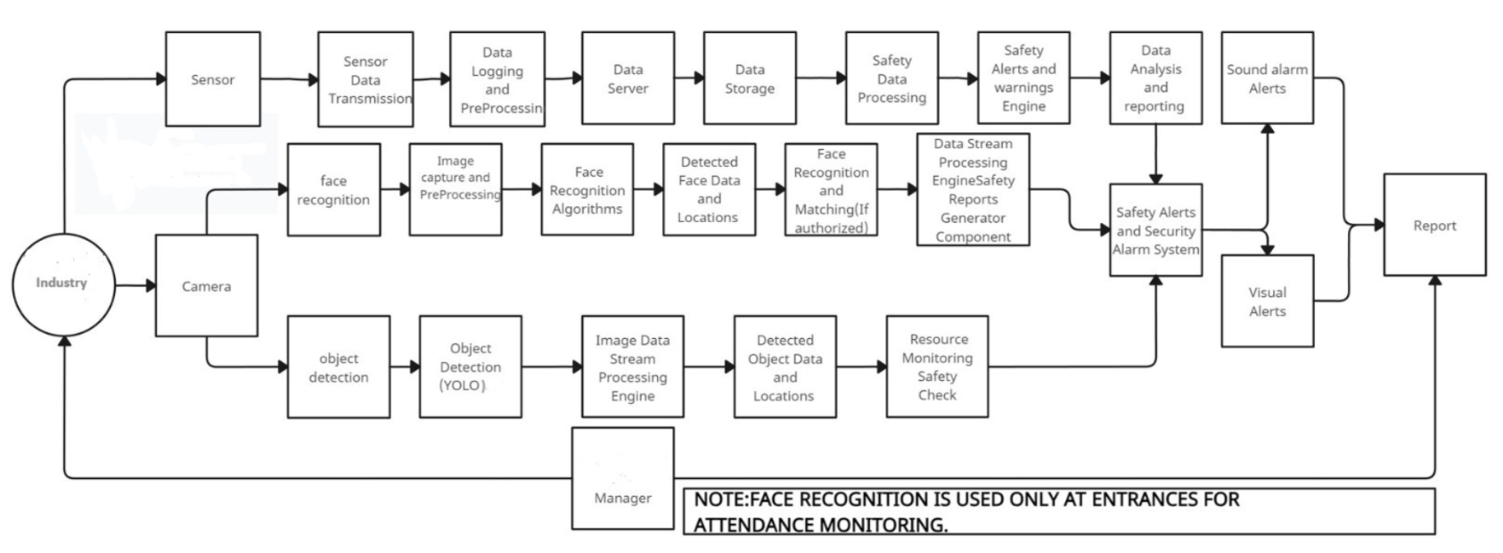
BLOCK
DIAGRAM

Slide 13
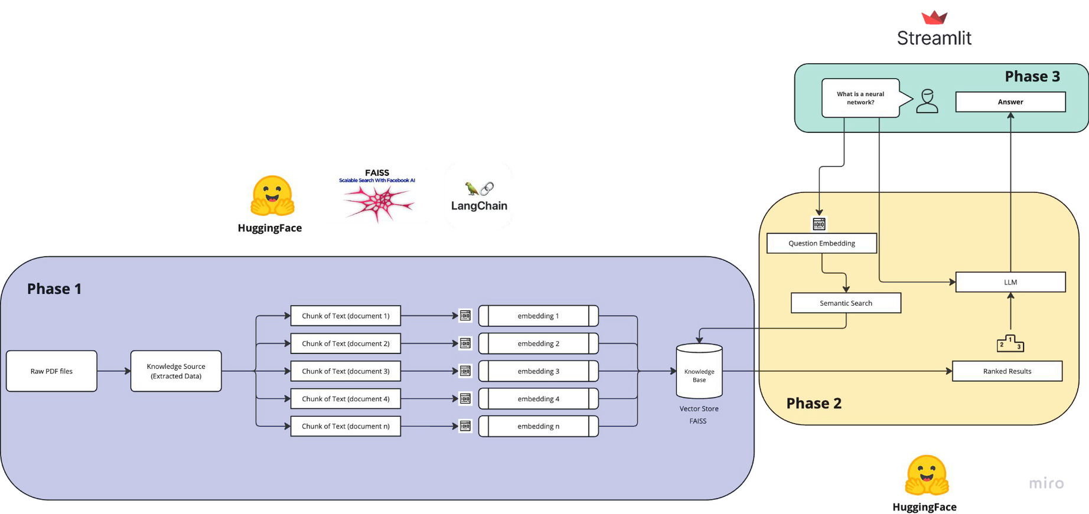

ARCHITECTURE
DIAGRAM

Slide 14
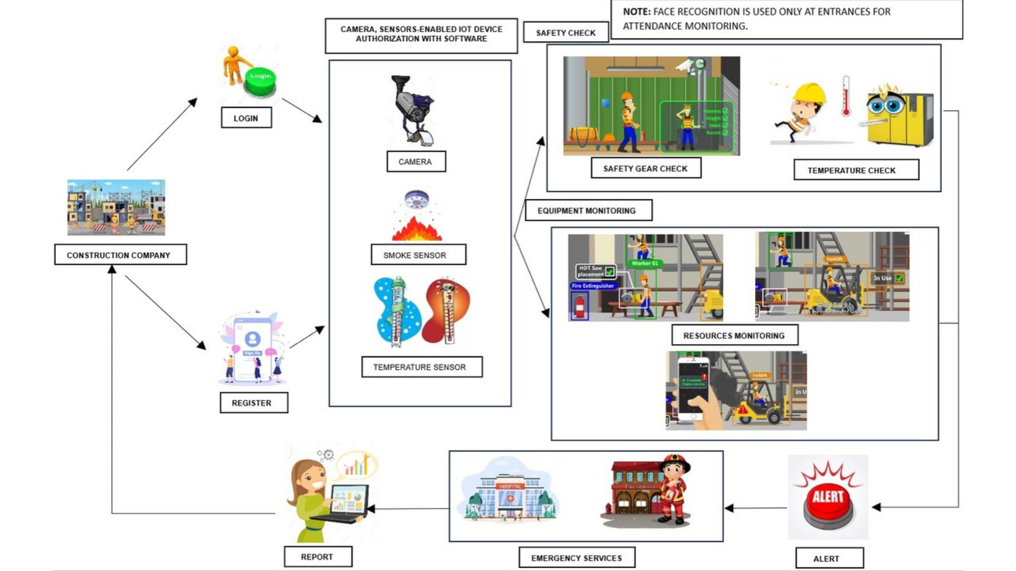
FLOW
DIAGRAM

Slide 15
LIST OF MODULES
The modules are
Image Acquisition
Image Segmentation
Image Classification

Slide 16
IMAGE ACQUISITION
Real-time Data Capture:
IP cameras continuously capture high-resolution images and video streams from the construction site.
Enables real-time monitoring of worker activities, material usage, and safety compliance.
Seamless Integration with AI Systems:
Captured images are processed using AI-based models for object detection, facial recognition, and hazard identification.
Ensures automated analysis and quick decision-making.
Remote Accessibility and Storage:
IP cameras transmit data over a network, allowing remote access and cloud-based storage.
Enables real-time surveillance and historical data analysis for improved site management.

Slide 17
IMAGE SEGMENTATION
Real-time Data Capture
High-resolution IP cameras provide continuous image/video streams.
Supports instant monitoring of workers, materials, and safety measures.
Seamless Integration with AI Systems
YOLO-based image segmentation enables fast, accurate detection of objects and hazards.
Automates analysis for quick, data-driven decisions.
Remote Accessibility and Storage
Networked cameras enable remote viewing and cloud storage.
Facilitates real-time oversight and long-term data analysis for efficient management.

Slide 18
Image Classification
Automated Recognition of Site Elements
Accurately classifies materials, machinery, and PPE (e.g., helmets, vests).
Reduces manual inspection time and human error.
Improved Safety Compliance
Identifies non-compliance like missing safety gear or unauthorized personnel.
Triggers alerts to ensure swift corrective actions.
Enhanced Operational Efficiency
Streamlines inventory checks and worker activity tracking through labeled data.
Supports data-driven decisions for site optimization.

Slide 19
Image Classification
Automated Recognition of Site Elements
Accurately classifies materials, machinery, and PPE (e.g., helmets, vests).
Reduces manual inspection time and human error.
Improved Safety Compliance
Identifies non-compliance like missing safety gear or unauthorized personnel.
Triggers alerts to ensure swift corrective actions.
Enhanced Operational Efficiency
Streamlines inventory checks and worker activity tracking through labeled data.
Supports data-driven decisions for site optimization.

Slide 20
PROJECT LAYOUT(NLP)
Setup Memory for LLM (Vector Database)
Load raw PDF(s)
Create Chunks
Create Vector Embeddings
Store embeddings in FAISS
Connect Memory with LLM
Setup LLM (Mistral with HuggingFace)
Connect LLM with FAISS
Create chain
Setup UI for the Chatbot
Chatbot with Streamlit
Load Vector store (FAISS) in cache
Retrieval Augmented Generation–RAG
Create chain

Slide 21










Business plan:
Target Market:
Large and medium-sized construction
Revenue Streams:
Local government and municipal construction projects.
College/School campuses with ongoing construction projects.
Ongoing metro projects in India.
Subscription-based pricing for construction companies.
Marketing Strategy:
Project-specific packages for college campuses and government projects.
Additional revenue from hardware sales and installation services.
Establish partnerships with local construction companies and colleges.
Participate in local construction industry events, trade shows, and engage with our audience through social media platforms.

Slide 22
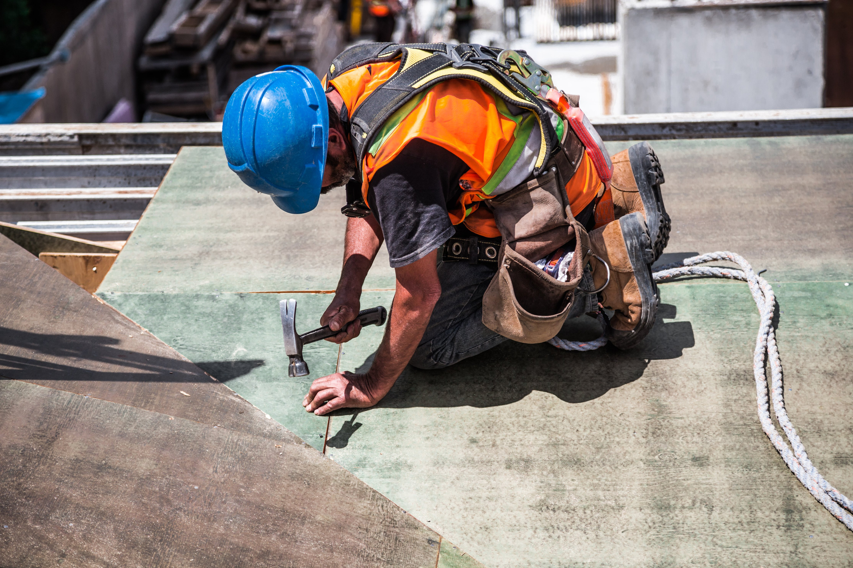
FUTURE ENHANCEMENT
As a future work,we are trying to reduce the computation time since it uses relatively high GPU memory footprint for images and because of many layers it takes significant amount to train.
Further improvement can be done by intergrating with IoT

Slide 23
CONCLUSION
Enhanced safety and compliance are achieved through AI-powered surveillance and facial recognition, which ensure worker safety by enforcing PPE compliance and restricting unauthorized access. Automated hazard detection and real-time alerts help minimize risks and prevent on-site accidents. Optimized resource and workflow management is enabled by drone-based material detection that accurately tracks inventory, reducing wastage and improving resource allocation, while AI-driven insights streamline workflow efficiency and support informed decision-making. Continuous site monitoring is facilitated by IP camera-based image acquisition, capturing worker activities and material usage, with AI models processing visual data in real time to enable quick responses and proactive safety measures. A smart, NLP-powered dashboard further enhances oversight by allowing managers to access site updates and generate reports using simple natural language queries.

Slide 24


